Slide 1
PART 2 Individual Behaviors and Processes in Organizations
CHAPTER 3
Individual Characteristics
Ricky W. Griffin/Jean M. Phillips/Stanley M. Gully, Organizational Behavior: Managing People and Organizations, Twelfth Edition. © 2020 Cengage. All Rights Reserved. May not be scanned, copied or duplicated, or posted to a publicly accessible website, in whole or in part.

Slide 2
Chapter Learning Objectives After studying this chapter, you should be able to:
Explain the nature of individual differences, the concept of fit, and the role of realistic job previews.
Define personality and describe general personality frameworks and attributes that affect behavior in organizations.
Identify and discuss other important personality traits that affect behavior in organizations.
Discuss different kinds of intelligence that affect behavior in organizations.
Describe different learning styles that influence how people process information and that affect behavior in organizations.

Slide 3
People in Organizations (1 of 2)
Individual differences
Personal attributes that vary from one person to another
The concept of fit
Person-job fit—The fit between a person’s abilities and the demands of the job, and the fit between a person’s desires and motivations and the attributes and rewards of a job
Person-group fit—The extent to which an individual fits with the workgroup’s and supervisor’s work styles, skills, and goals
Person-organization fit— The fit between an individual’s values, beliefs, and personality and the values, norms, and culture of the organization
Person-vocation fit—The fit between a person’s interests, abilities, values, and personality and a profession

Slide 4
People in Organizations (2 of 2)
Realistic job previews (RJPs)
Present both positive and potentially negative information to job candidates
Goal is not to deter candidates, but to:
Provide accurate information about job and organization
Build trust
Reduce turnover (especially from employees who quit because the job wasn’t what they expected)

Slide 5
Personality and Individual Behavior (1 of 3)
Personality
The relatively stable set of psychological attributes that distinguish one person from another, nature versus nurture?
The “Big Five” personality traits
A set of fundamental traits that are especially relevant to organizations
Agreeableness | The ability to get along with others
Conscientiousness | Refers to an individual being dependable and organized
Neuroticism | Characterized by a person’s tendency to experience unpleasant emotions such as anger, anxiety, depression, and feelings of vulnerability
Extraversion | The quality of being comfortable with relationships
Introversion | The tendency to be less comfortable in relationships and social situations
Openness | The capacity to entertain new ideas and to change as a result of new information

Slide 6
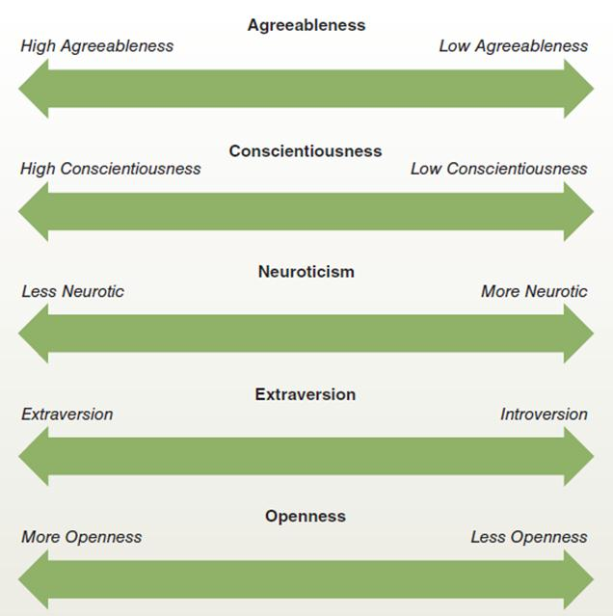
“Big Five” personality traits
Figure 3.1
The “big five” personality framework is currently very popular among researchers and managers. These five dimensions represent fundamental personality traits presumed to be important in determining the behaviors of individuals in organizations. In general, experts agree that personality traits closer to the left end of each dimension are more positive in organizational settings, whereas traits closer to the right are less positive.

Slide 7
Personality and Individual Behavior (2 of 3)
The Myers-Briggs framework
Used to categorize personality
Differentiation across four general dimensions
Extroversion (E)/Introversion (I)
Sensing (S)/Intuition (N)
Thinking (T)/Feeling (F)
Judging (J)/Perceiving (P)

Slide 8
Personality and Individual Behavior (3 of 3)
Sixteen personality classifications result from the higher and lower positions of the general dimensions
Myers-Briggs type indicator (MBTI) is a popular questionnaire used to assess personality types
Communications styles
Interaction preferences

Slide 9
Other Important Personality Traits (1 of 2)
Locus of control | The extent to which one believes one’s circumstances are a function of either one’s own actions or of external factors beyond one’s control
Self-efficacy | A person’s confidence in his or her ability to organize and execute the courses of action necessary to accomplish a specific task
General self-efficacy | Your generalized belief that you will be successful at whatever challenges or tasks you might face
Self -esteem | Our feelings of self-worth and our liking or disliking of ourselves
Authoritarianism | The belief that power and status differences are appropriate within hierarchical social systems such as organizations

Slide 10
Table 3.2 Effects of Locus of Control on Organizational Outcomes
Organizational Outcome | Internal versus External Locus of Control
Job satisfaction | Internals are generally more satisfied with their job, pay, supervisor, and coworkers.
Commitment | Internals are more committed and have lower absenteeism.
Job motivation | Internals have greater task motivation, job involvement, and self-confidence than do externals.
Job performance | Internals tend to have higher job performance than externals.
Career success | Internals tend to earn a higher salary than do externals.
Conflict and stress | Internals report lower role conflict, work-family conflict, burnout, and stress than do externals
Social integration | Internals tend to be more socially integrated at work and report more favorable relationships with their supervisors
Source: Adapted from See Ng, T.W.H., Sorensen, K.L., & Eby, L.T. (2006). Locus of Control at Work: A Meta-Analysis, Journal of Organizational Behavior, 27, 1057-1087

Slide 11
Other Important Personality Traits (2 of 2)
Machiavellianism | Traits causing a person to behave in ways to gain power and control the behavior of others
Tolerance for risk (or risk propensity) | The degree to which a person is comfortable with risk and is willing to take chances and make risky decisions
Tolerance for ambiguity | Reflects the tendency to view ambiguous situations as either threatening or desirable
Type A personality | Impatient, competitive, ambiguous, and uptight
Type B personality | More relaxed and easygoing, less overtly competitive than Type A; handles stress less frantically
Bullying personality | Repeated mistreatment of another employee through verbal abuse; conduct that is threatening, humiliating, or intimidating; or sabotage that interferes with the other person’s work.
The relationship between personality and behavior changes depending on the strength of the situation.

Slide 12
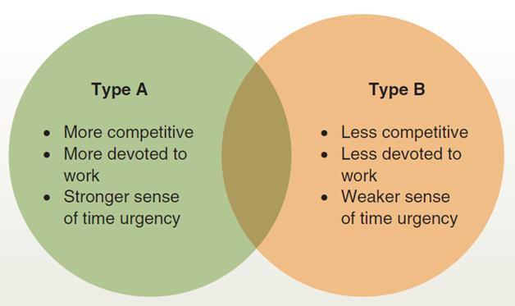
Type A and B Traits
Figure 3.2
Few people have extreme Type A or Type B personality profiles. Instead, people tend toward one type or the other. This is reflected by the overlap between the profiles shown here.

Slide 13
Intelligence (1 of 3)
General mental ability
The capacity to rapidly and fluidly acquire, process, and apply information
Information processing capacity
Involves the manner in which individuals process and organize information

Slide 14
Intelligence (2 of 3)
Gardner’s Theory of Multiple Intelligences
Linguistic | Words and language
logical-mathematical | Logic and numbers
Musical | Music, rhythm, and sound
bodily-kinesthetic | Body movement and control
spatial-visual | Images and space
Interpersonal | Other people’s feelings
Intrapersonal | Self-awareness
This theory says there is more than one way to be smart. Important for determining different learning preferences.

Slide 15
Intelligence (3 of 3)
Emotional intelligence (EQ)
An interpersonal capability that includes the ability to perceive and express emotions, to understand and use them, and to manage emotions in oneself and other people
Self-awareness: being aware of what you’re feeling
Self-motivation: persisting in the face of obstacles, setbacks, and failures.
Self-management: managing your own emotions and impulses
Empathy: sensing how others are feeling
Social skills: effectively handling emotions of others

Slide 16
Table 3.4 Matching Intelligence Types with Career Choices (1 of 2)
Type of Intelligence | Related Careers | Preferred Learning Style
Bodily-Kinesthetic:physical agility and balance; body control; hand-eye coordination | Athletes, firefighters, chefs, actors, gardeners | Touch and feel, physical experience
Interpersonal: ability to relate to others and perceive their feelings; interprets behaviors of others; relates to emotional intelligence | Psychologists, doctors, educators, salespeople, politicians | Human contact, teamwork
Intrapersonal: self-awareness; understands oneself and one’s relationship to others and to the world; relates to emotional intelligence | Related to success in almost all careers | Self-reflection, self-discovery
Linguistic: verbal and written language; explaining and interpreting ideas and information | Authors, speakers, lawyers, TV and radio hosts, translators | Verbal and written words and language
Source: Based on Gardner, H. (1983). Frames of Mind. New York: Basic Books; Gardner, H. (1993a). Multiple Intelligences: The Theory in Practice. NY: Basic Books; Gardner, H. (1993b). Creating Minds. NY: Basic Books; Marks-Tarlow, T. (1995). Creativity Inside Out: Learning Through Multiple Intelligences. Reading, MA: Addison-Wesley.

Slide 17
Table 3.4 Matching Intelligence Types with Career Choices (2 of 2)
Type of Intelligence | Related Careers | Preferred Learning Style
Logical-Mathematical: logic and pattern detection; analytical; problem solving; excels at math | Engineers, directors, scientists, researchers, accountants, statisticians | Logic and numbers
Musical:recognition of rhythm and tonal patterns; musical ability; high awareness and use of sound | Musicians, DJs, music teachers, acoustic engineers, music producers, composers | Music, Sounds, and rhythm
Spatial-Visual: creation and interpretation of visual images; visual and special perception | Artists, engineers, photographers, inventors, beauty consultants | Pictures, shapes, visually
Source: Based on Gardner, H. (1983). Frames of Mind. New York: Basic Books; Gardner, H. (1993a). Multiple Intelligences: The Theory in Practice. NY: Basic Books; Gardner, H. (1993b). Creating Minds. NY: Basic Books; Marks-Tarlow, T. (1995). Creativity Inside Out: Learning Through Multiple Intelligences. Reading, MA: Addison-Wesley.

Slide 18
Learning Styles
Learning styles—Individual differences and preferences in how we process information while problem-solving, learning, or engaging in similar activities
Sensory modalities approach
Visual: learning by seeing
Auditory: learning by hearing
Tactile: learning by touching
Kinesthetic: learning by doing

Slide 19
Kolb Learning Style Inventory
Convergers | Learn by active experimentation and abstract conceptualization; superior in technical tasks, inferior in interpersonal settings
Divergers | Learn by concrete experience and reflective observation; superior in generating alternate hypotheses and ideas; tend to be imaginative and people or feeling-oriented
Assimilators | Learn by abstract conceptualization and reflective observation; more concerned about abstract concepts and logical soundness than about people and practical values; suited to research and planning
Accommodators | Learn by active experimentation and concrete experience; focus on risk taking, opportunity seeking, and action; deal with people easily; suited to action-oriented jobs such as marketing and sales

Slide 20
Learning Style Orientations
Discovery learning | An inclination for exploration during learning
Experiential learning | A desire for hands-on approaches to instruction
Observational learning | A preference for external stimuli such as demonstrations and diagrams
Structured learning | A preference for processing strategies such as taking notes, writing down task steps, subjective assessments
Group learning | Preference to work with others while learning, active and interactional

Slide 21
Organizational Behavior in Action
After reading the chapter:
What is a psychological contract? Why is it important? What psychological contracts do you currently have?
What individual differences do you feel are most important to organizations? Why?
If you were denied a job because of your score on a personality test, what would be your reaction?
If your supervisor exhibited bullying behaviors, what would you do?
Which of Gardner’s multiple intelligences do you feel are most important for managers?

